Slide 1
DT 228-1 and DT282-1 Computer Architecture and Technology
Tutorial 7

Slide 2
Questions and Answers ( 1 )
What is computer architecture?
The description of how the components of a hardware system exchanges signals as part of the structure and function of the computer system.
Views of architecture:
‘Whole system’ view
Fetch execute cycle view
CPU view

Slide 3
Whole System View
The whole system view includes:
Motherboard and all connected components
Peripheral devices
Network to other devices

Slide 4
Fetch Execute Cycle View
The fetch execute cycle view has an ‘instruction context’ here (as opposed to an electromechanical, or hardware, focus), and includes:
Input (devices)
Central Processing Unit
Memory
Output (devices)

Slide 5
Central Processing Unit View
The CPU view has a hardware context here, and includes:
Program Counter
Registers
ALU – Arithmetic Logic Unit
Control Unit

Slide 6
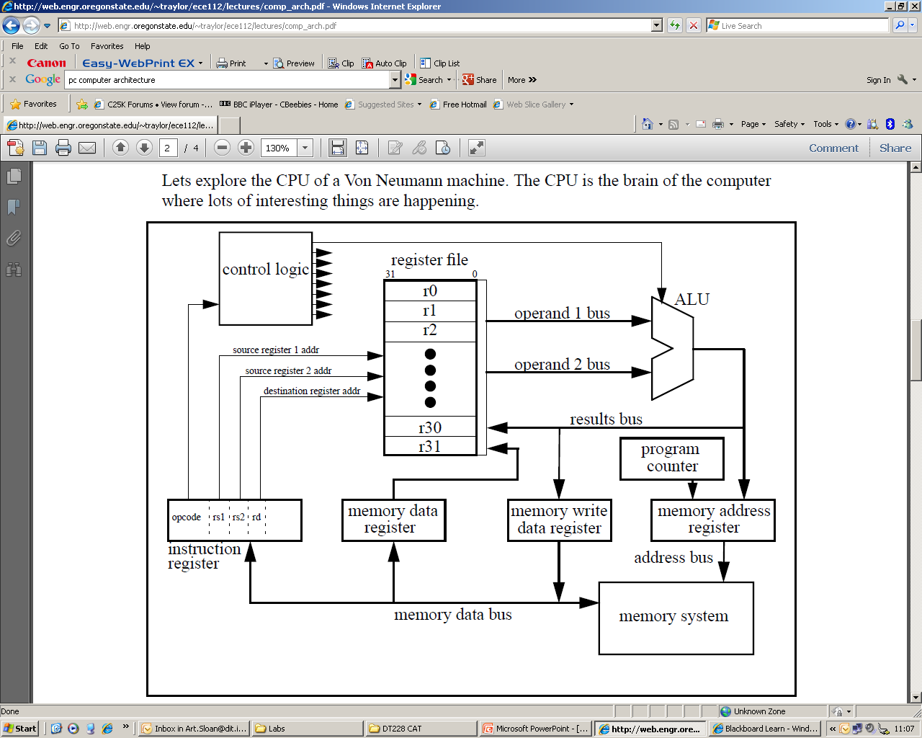
Questions and Answers ( 1 )

Slide 7
Youtube – Computer Architecture
Interesting Youtube clip:
https://www.youtube.com/watch?v=OuYLwPz9vvA

Slide 8
Typical Exam (Sub) Question For This Content
Question
What are the principles of von Neumann Architecture and what are the functional sub-components of that architecture?
Sample solution
The von Neumann architecture is a computer design model that uses a single storage structure to hold both instructions and data.
The term describes such a computer, which implements a Universal Turing machine, and the common "referential model" of specifying sequential architectures, in contrast with parallel architectures.
The separation of storage from the processing unit is implicit in the von Neumann architecture.

Slide 9
Solution continued
The term "stored-program computer" is generally used to mean a computer of this design.
Von Neumann begins his idea with a broad description of the general-purpose computing machine containing four main ‘sub-components’. These are identified as relating to arithmetic, memory, control, and connection with the human operator: - the arithmetic logic unit, the control unit, the memory, and the input-output devices of the classical computer model.
To von Neumann the key to building a general purpose device was in its ability to store not only its data and the intermediate results of computation, but also to store the instructions, or orders that brought about the computation.

Slide 10
Solution continued
In a special purpose machine the computational procedure could be part of the hardware. In a general purpose one the instructions must be as changeable as the numbers they acted upon. Therefore, why not encode the instructions into numeric form and store instructions and data in the same memory? This frequently is viewed as the principal contribution provided by von Neumann's insight into the nature of what a computer should be.
(10 marks)

